Slide 1
Worldbank commodity prices
Crude oil, Precious Metals, Timber and Natural Gas

Slide 2
history
Crude oil originated from Baku in 1837 where the first commercial oil refinery was established to distil oil into paraffin.
The first oil well was established 1846 and other wells in Poland(1854),Canada(1858) and others with USA in 1859
90% of the world’s oil production was from Persia(now known as Iran)
In 1870, John D. Rockefeller established Standard Oil Co. in Ohio in the US which became a dominant player in oil produce hence driving prices down and buying up competition.
Discovery of Oklahoma in Cushing in the year 1912 which later in 1949 became the settlement point for WTI oil
Brent crude along with WTI(West Texas Intermediaries) set as the bench mark for all oil prices in the world.
Finally the Nationalization of oil productions after the world war II from 1950-1960.

Slide 3
Some uses of crude oil
Petroleum
Gasoline
Propane
Diesel
Hydrocarbon gas liquids
Heating oils
Asphalt

Slide 4
CAUSES OF FLUCTUATIONS IN PRICES
The major causes of fluctuations in WorldBank prices of crude oil are Supply and Demand.
More generally; Higher demand, less supply; increase in prices while higher supply less demand; decrease in prices.
These demand factors were caused by the technological advancement.
The happenings of wars between countries all around the world.
Financial crisis of some influential countries as well as global financial crises e.g. Asia(China) in 1997
The changes in prices from 2008-2009 were demand driven.(Asia’s demand increased)

Slide 5
Causes of fluctuations in prices
The supply factors on the other hand were caused by wars among countries all around the world.
Formation of the Seven Sisters( IOCs; International Oil Companies) which were a combination of major oil refineries.
Revolutions and resolutions of a group of countries against other countries.
Formation of OPEC(Organization of Petroleum Exporting Countries) in 1960
The discovery oil fields in North sea(Norway and UK) in mid-1970s.
Production cuts, embargos, fall of the soviet union and others.
Changes in prices from 1985-1986 were supply driven.

Slide 6
Other causes
The OPEC embargo on oil exports to the US due to the support they gave to Israel against Egypt in the Yom Kippur War of 1973.
Iranian revolution of 1970-1980.
1990 invasion of Kuwait by Iran.

Slide 7
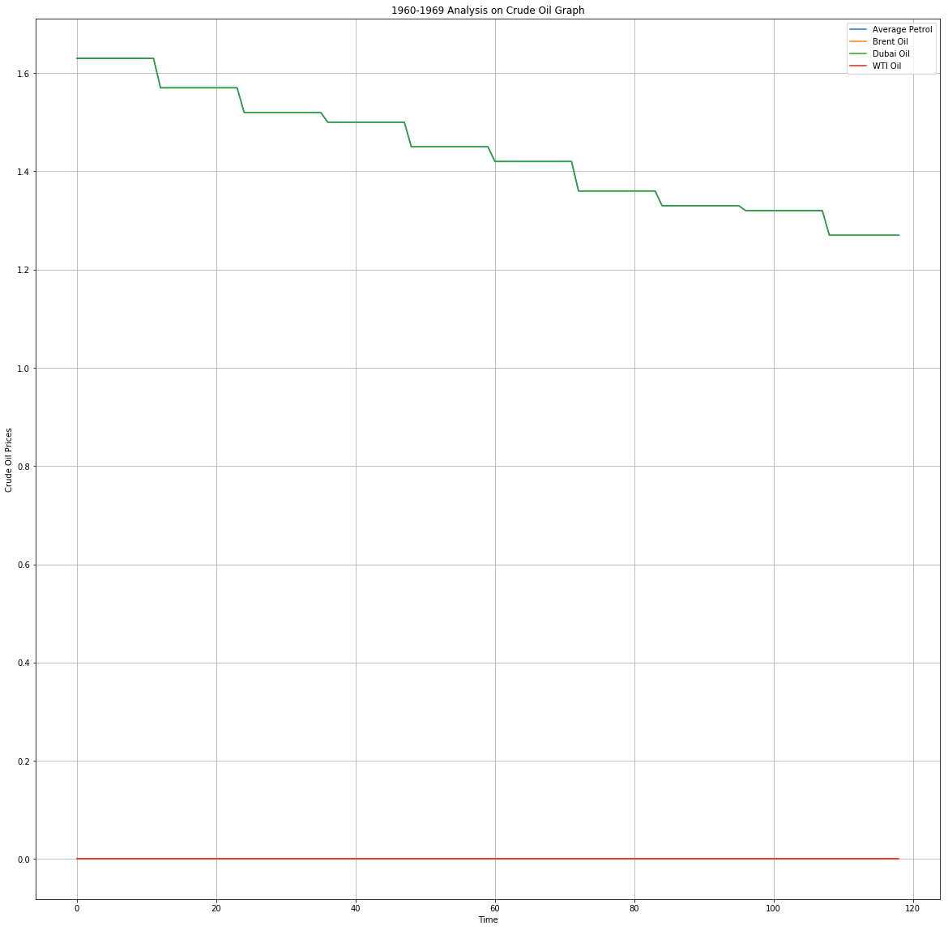

Slide 8
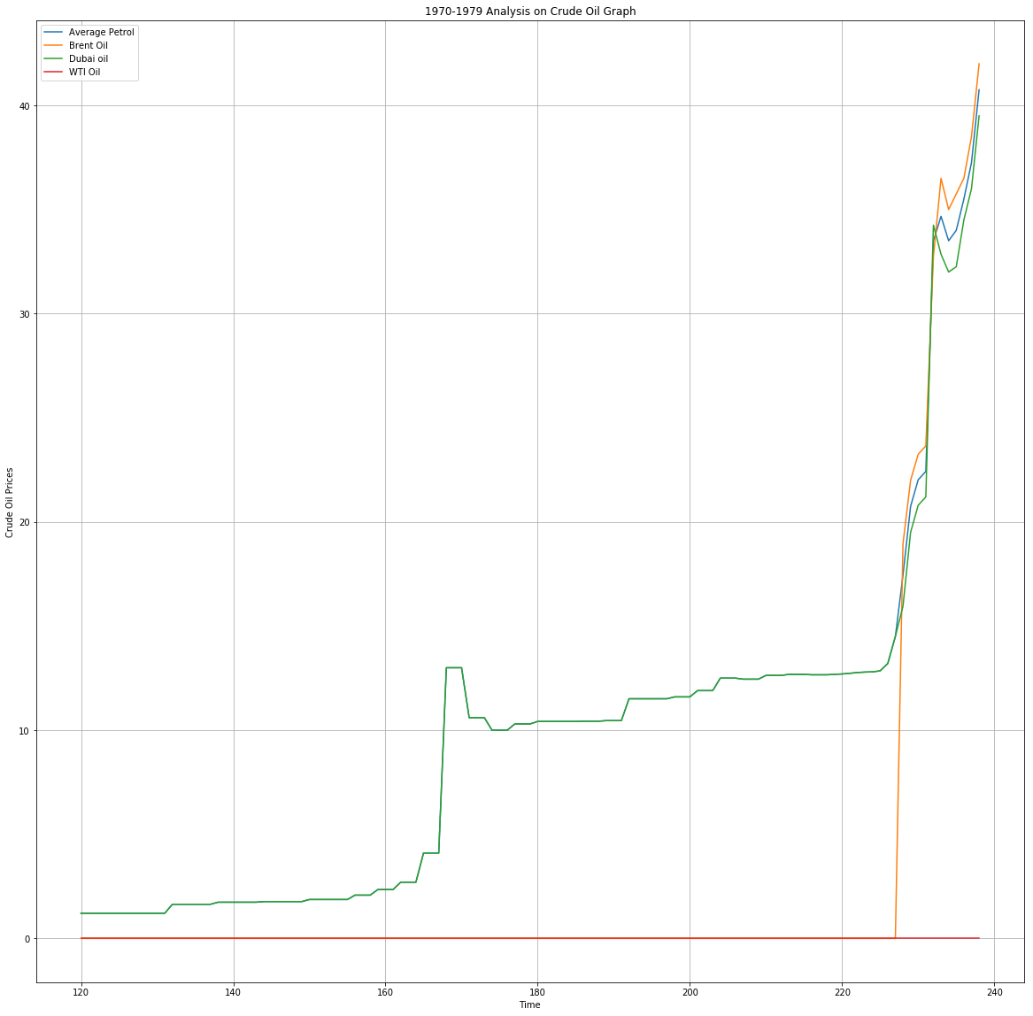

Slide 9
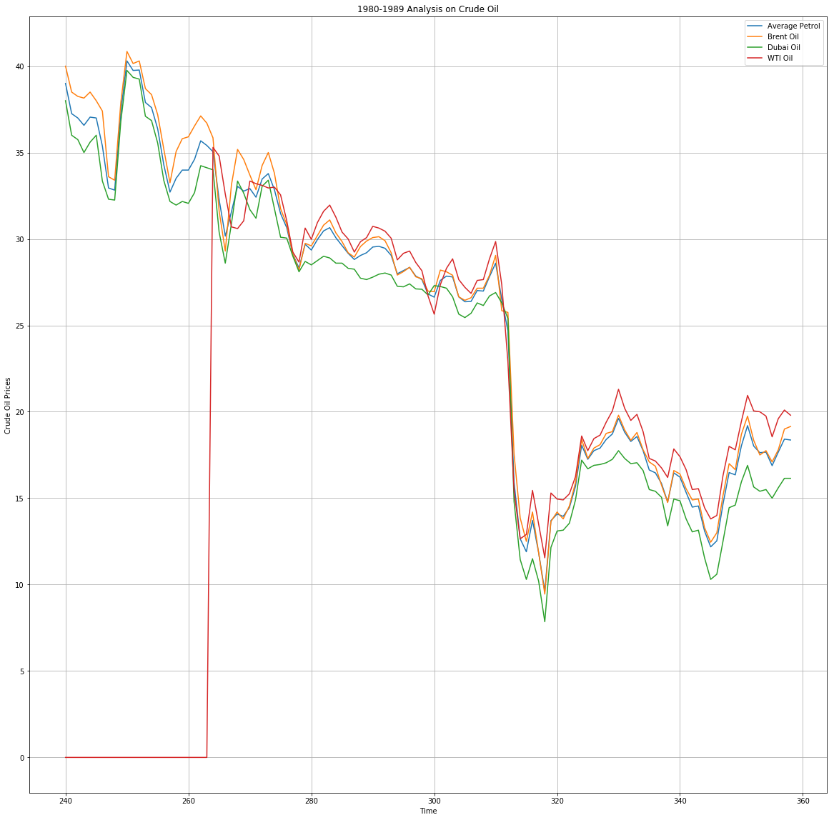

Slide 10
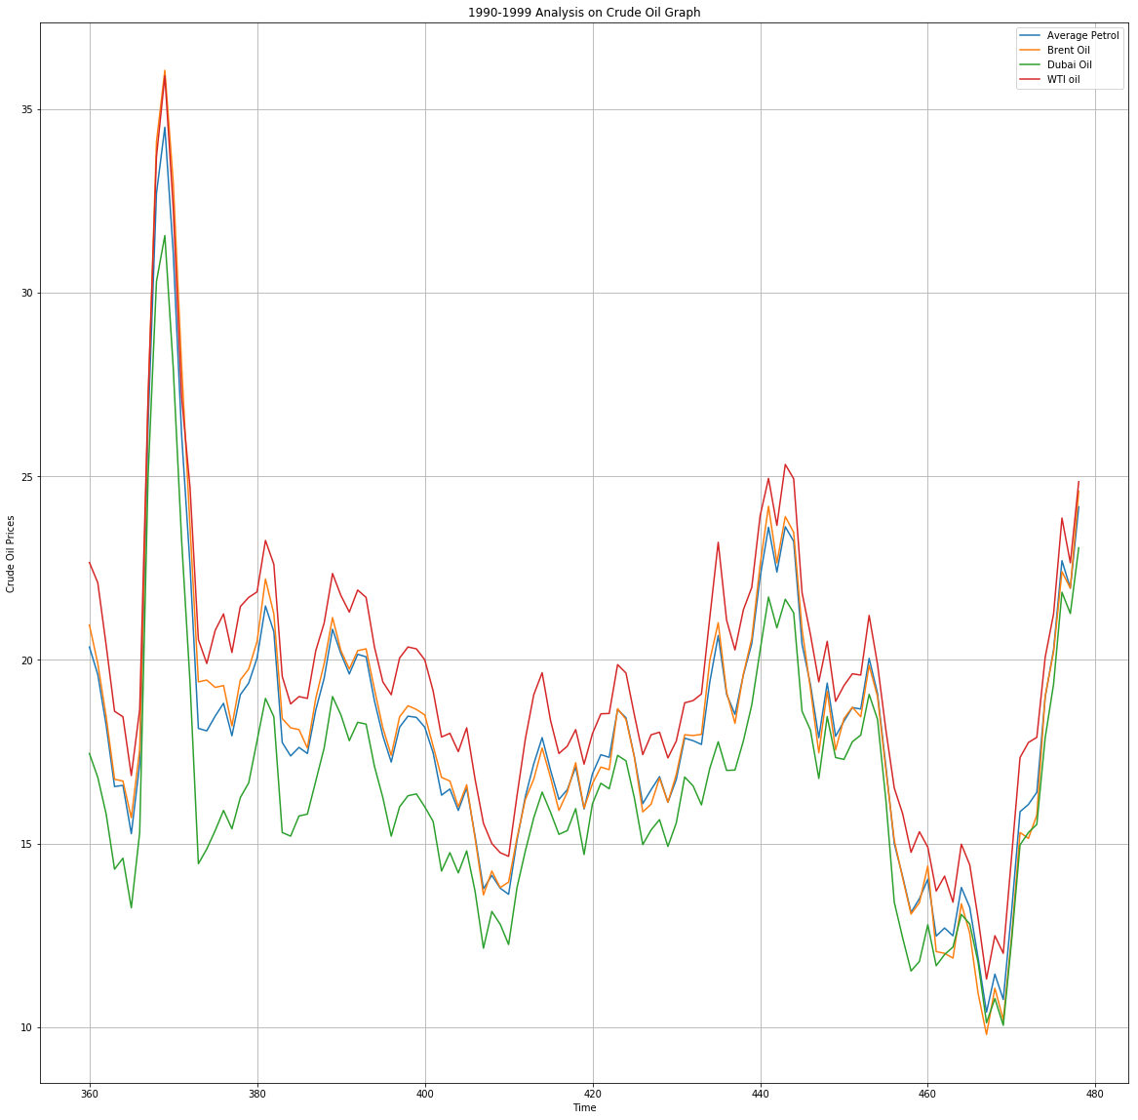

Slide 11
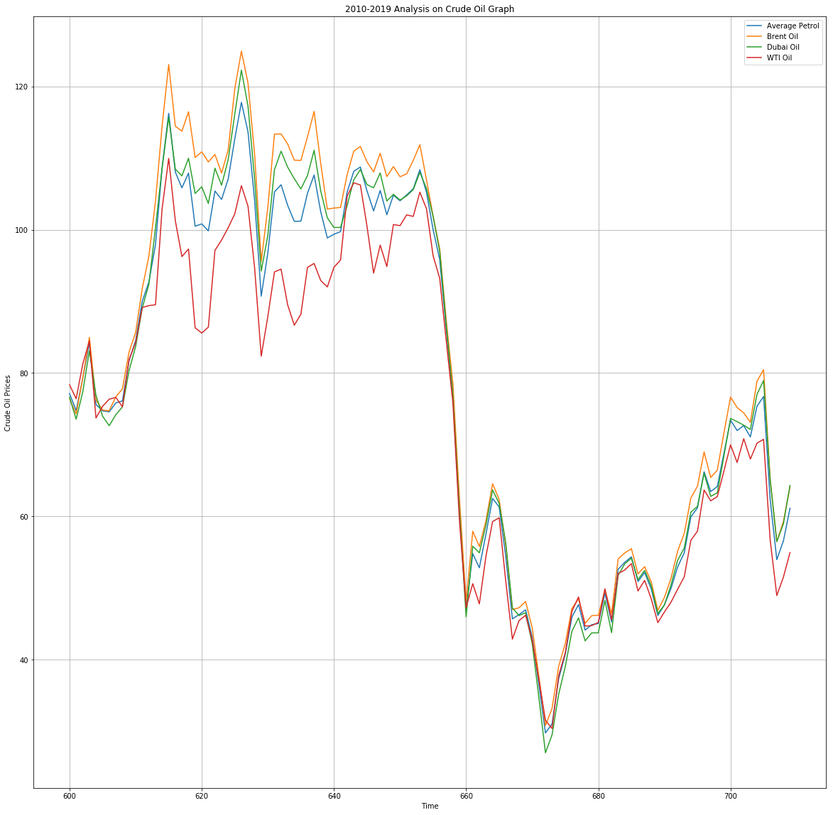

Slide 12
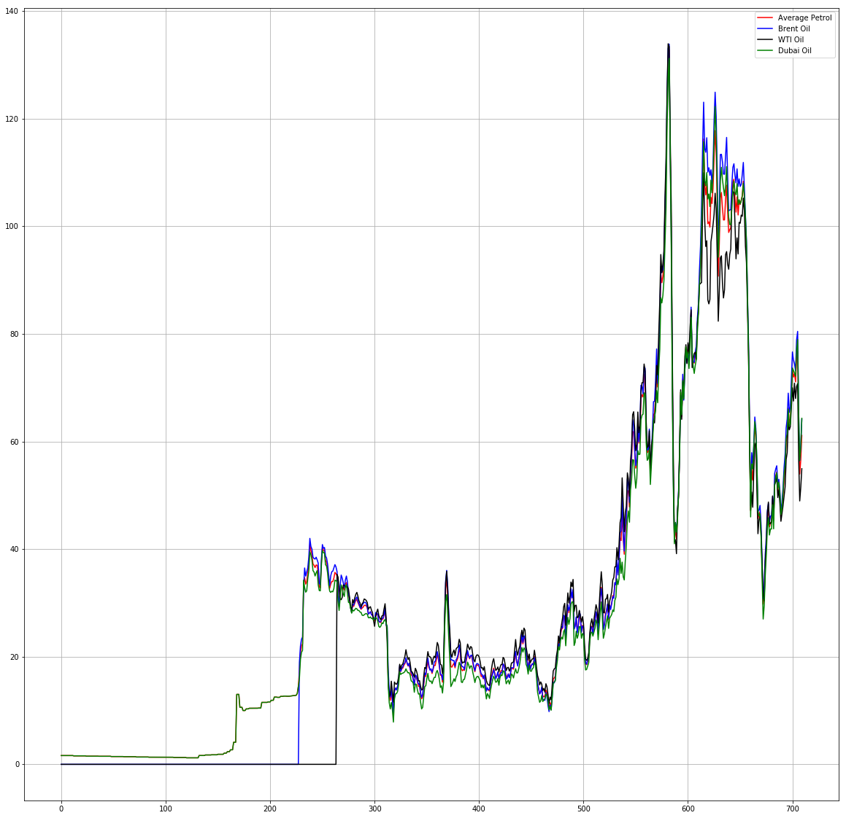

Slide 13
Future resolutions in prices of oil
Global oil reserves of about 1.67 trillion barrels will be exhausted by 2050-2060
This implies that consumption of crude oil produce of about 92million barrels will increase over the decades.
Prices of oil are assumed to go down in 2019

Slide 14
Precious Metals Analysis
Silver : Gold Ratio
The silver : gold ratio tells us the proportional relationship between the silver price and gold price or, in other words, how many ounces of gold it is possible to buy with one ounce of silver. It is not a fixed ratio, and fluctuates constantly depending on the metals' current prices. While some of the same factors, namely inflation and the performance of the global economy, influence their prices, they don’t always change at the same rate. As such this ratio has changed a lot throughout history.
5 Year Ratio
Silver is certainly the more volatile of the two metals. Although it has always been cheaper than gold, the extent to which this is the case has varied wildly throughout time. Looking at the 5 year silver : gold ratio gives us an excellent example of this. In mid-2011, when the prices for both silver and gold peaked, the ratio was around 0.031, meaning that silver was approximately 30 times cheaper than gold. Just 5 years later, in early 2016, that ratio now stands close to 0.015, making silver nearly 80 times cheaper.
The chart is a useful tool for investors, as it can give them a important insight into which of the metals is better value for money at any given moment. We can see from the 5 year chart that silver has become incredibly cheap compared to gold and, with silver's volatile nature taken into account, could quickly become much more expensive in a more bullish precious metals market.

Slide 15
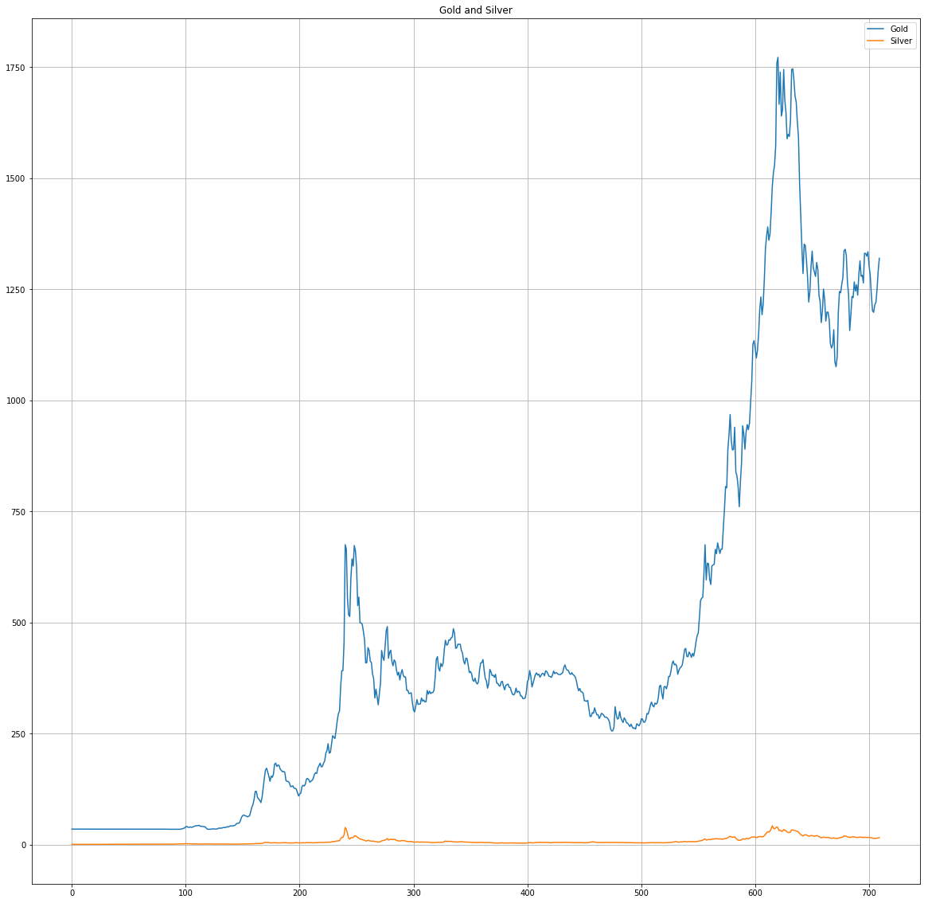
Gold and Silver

Slide 16
Five year ratio
Gold : Platinum 5 Year Ratio
Our regularly updated gold: platinum ratio charts allow you to determine which of the metals is a stronger investment by tracking and comparing the historical and current ratios. The gold : platinum ratio is the proportional relationship between the respective prices of gold and platinum. In simple terms it demonstrates how many troy ounces of platinum you can buy with one oz t. of gold. It is a fairly simple ratio to understand; when it is above 1, platinum is cheaper than gold.
Using the Ratio
The gold to platinum ratio is a useful tool to refer to when deciding which of the metals is the better investment. Although it is always a good idea to diversify your investment in different metals, you can use the ratio to determine whether it may be a better time to buy gold or platinum at any given time.
Both metals are incredibly rare and much more expensive than silver. However, of the two, platinum is by far the rarest. Although it is not the case right now, platinum has generally been more expensive than gold. It is more difficult to find and has much higher demand due to its use in machinery such as catalytic converters.
Periods in which gold has been more expensive than platinum are rare, and have always been relatively short lived. With this in mind, an investor may view any moment where the ratio is below 1 as an ideal moment to buy platinum, expecting it to return to its more historically common relationship

Slide 17
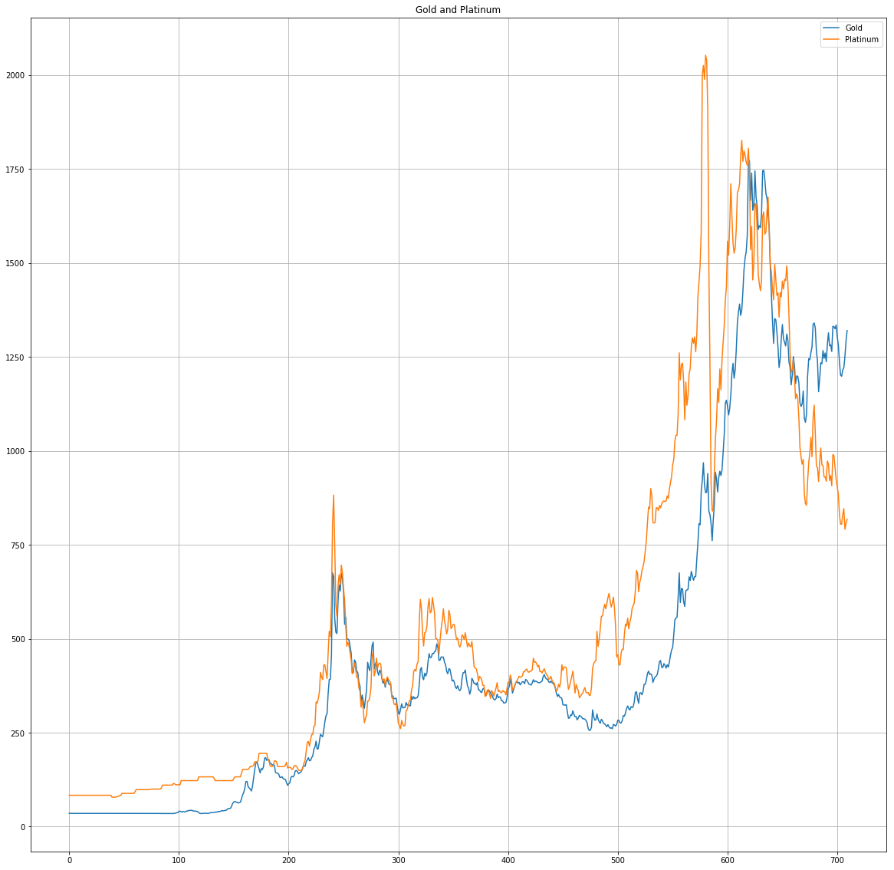
Gold and Platinum

Slide 18
The platinum: silver ratio tells us the relative quantitative values of platinum and silver or, in other words, the amount of silver that can be bought with a troy ounce of platinum. Given the two metals' different industrial uses, the respective prices of platinum and silver fluctuate at different times and at different rates, causing the ratio to fluctuate. It is a straightforward relationship to understand, the higher the ratio, the more expensive platinum is compared to silver and vice versa.
5 Year Ratio
By far the rarest of the precious metals, platinum has always tended to be worth a considerable amount more than silver. However the ratio hit a record low in 2011, as the silver price peaked and platinum entered a dip that has continued over the last 5 years. Although it has recovered slightly since then, it still sits much closer to its lowest point than its peak. While platinum once cost as much as 154 times more than silver, in early 2016 this ratio has now hovers at around 60.
This has occurred during a period in which the prices of all precious metals have dropped significantly after peaking in mid-2011. Platinum, however, has fallen much further than the other metals relative to its historical price, meaning the ratio is much lower than it tends to be

Slide 19
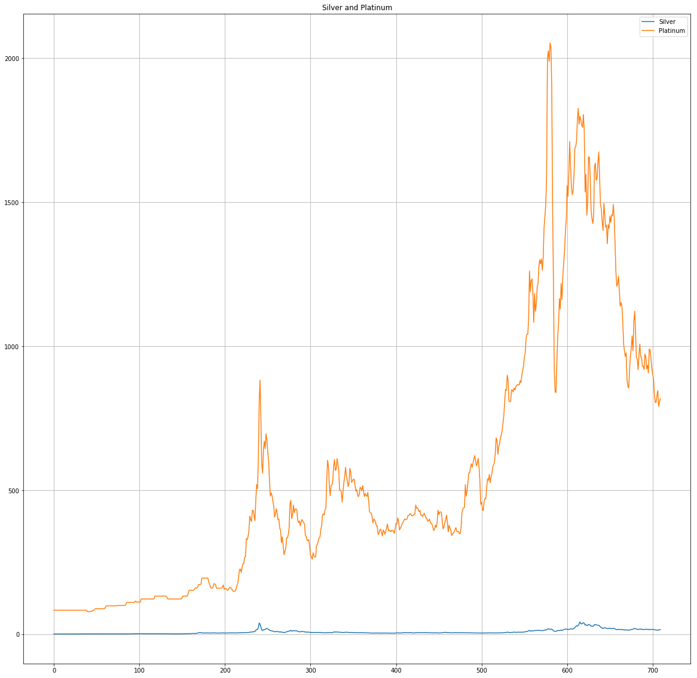
Silver and Platinum

Slide 20
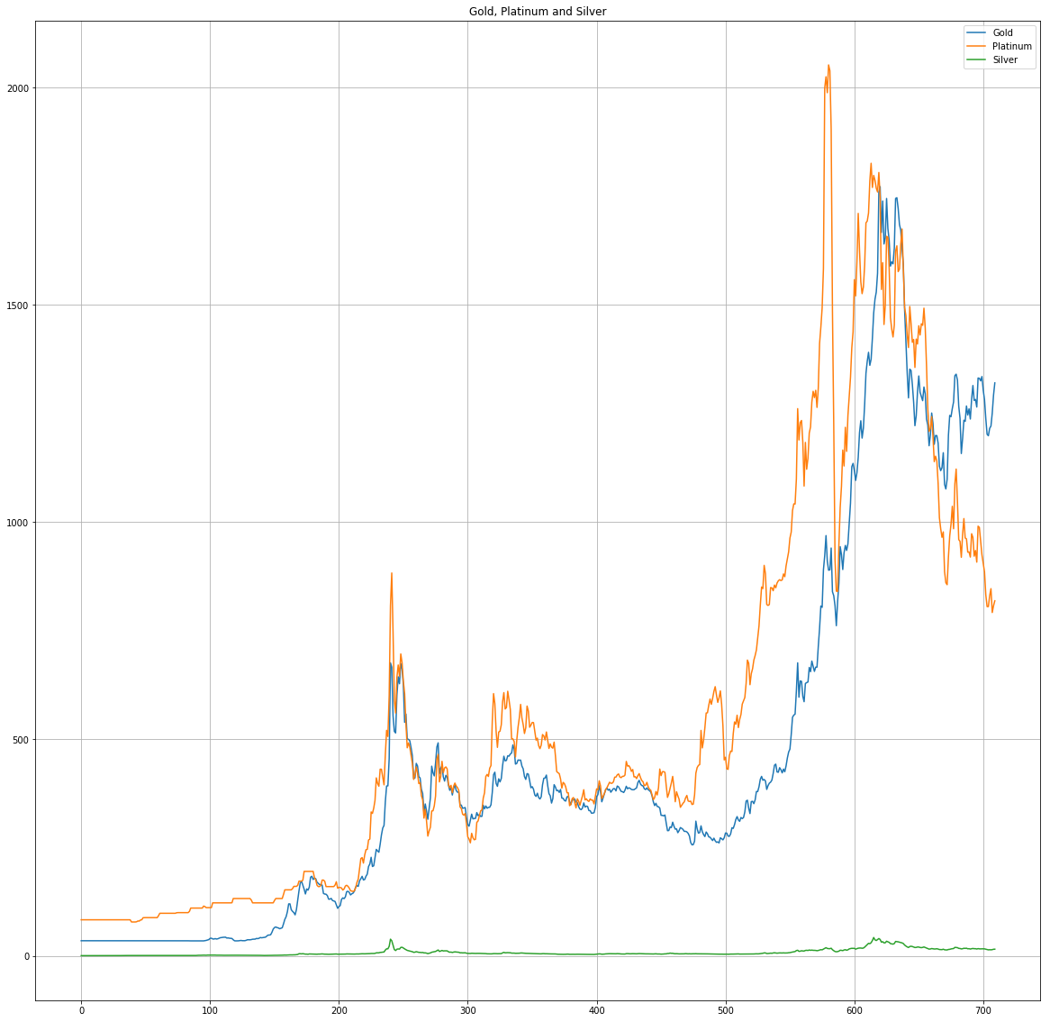

Slide 21
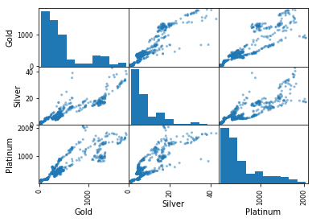

Slide 22
Timber
Timber is a type of wood that has been processed into beams and planks, a stage in the process of wood production. Timber is gotten from trees. According to our data, the type of timber given to us are
Sawn wood Cameroon
Sawn wood Malaysia
Plywood
Wood pulp.

Slide 23
Sawn wood Cameroon
Over the first 8 months 2018, Cameroon shipped the largest volume of tropical sawn timber to Germany, the International Tropical Timber Organization (ITTO) said. Figures showed that Cameroonian exports went up 25% to 4,500 m3, over the period.

Slide 24
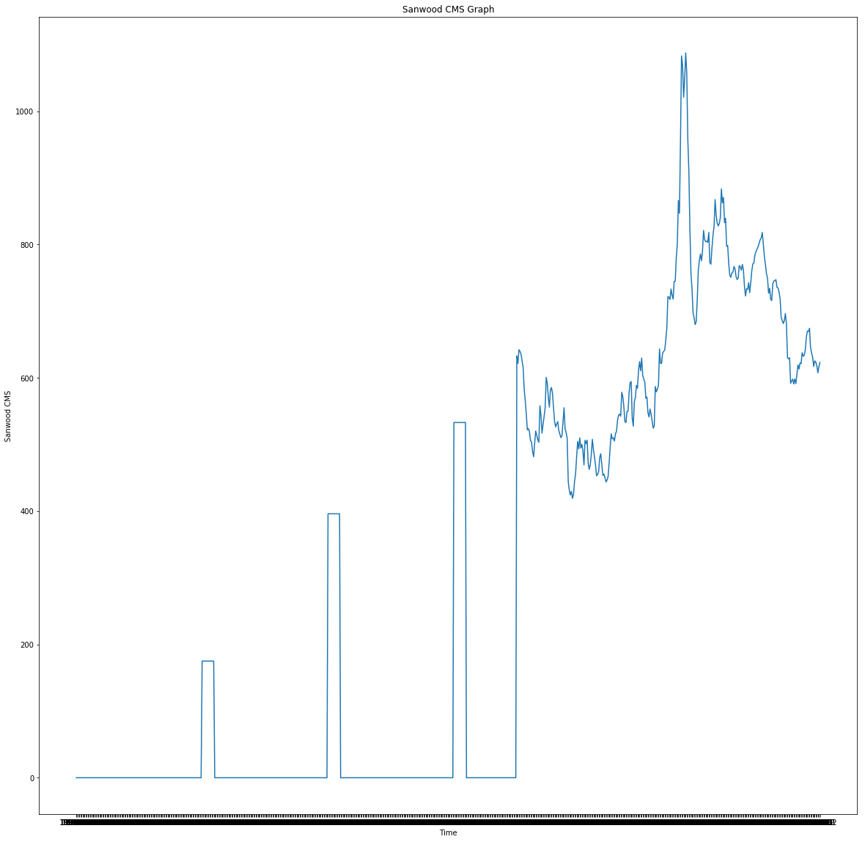
According to our graph, there were no prices for sawn wood Cameroon in (1960-1969), (1971-1979),(1981-1989),(1991,1994).

Slide 25
Sawn wood Malaysia Malaysia is a country well known for its tropical timber forests and for its trading and relationships with many European countries. Our logging system used in the country is called "Selective Management System" (SMS) and is based on the pre-selection of the tress to be cut, of which it must have a life cycle of 25 to 30 years. It will contribute both to the conservation and evolution of species and to the maximum utilization of the raw material. The system was initially used by the British (Malaysia was a British Colony) and was maintained all these years. It is very functional and detailed system for logging process. In May 2009, Malaysia received International recognition for its timber certification mark and become the first country in Asia to receive it and the second in the world after Gabon. The mark was given by PEFC - "Programme for Endorsement of Forest Certification Schemes".

Slide 26
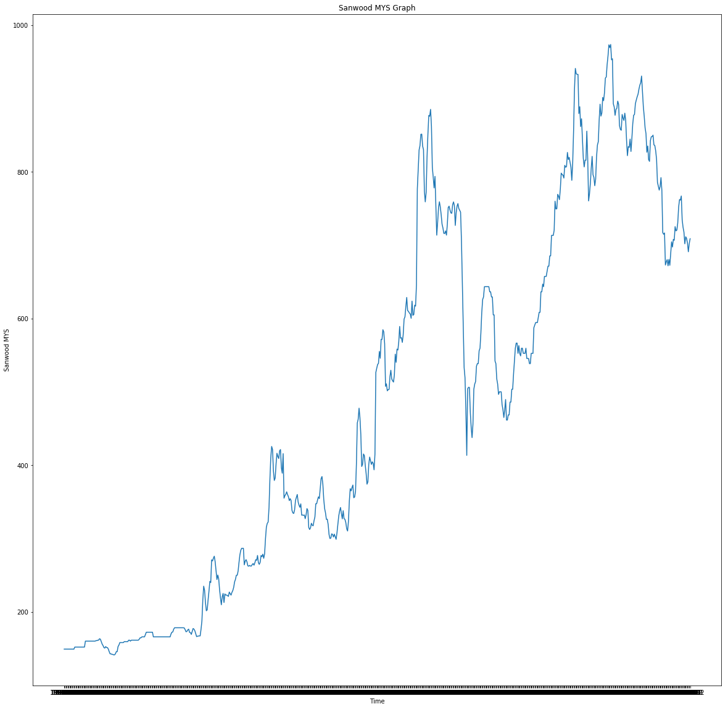
Sawn wood Malaysia

Slide 27
PLYWOOD Plywood is a material manufactured from thin layers or "plies" of wood veneer that are glued together with adjacent layers having their wood grain rotated up to 90 degrees to one another. It is an engineered wood from the family of manufactured boards which includes medium-density fibreboard (MDF) and particle board (chipboard).

Slide 28
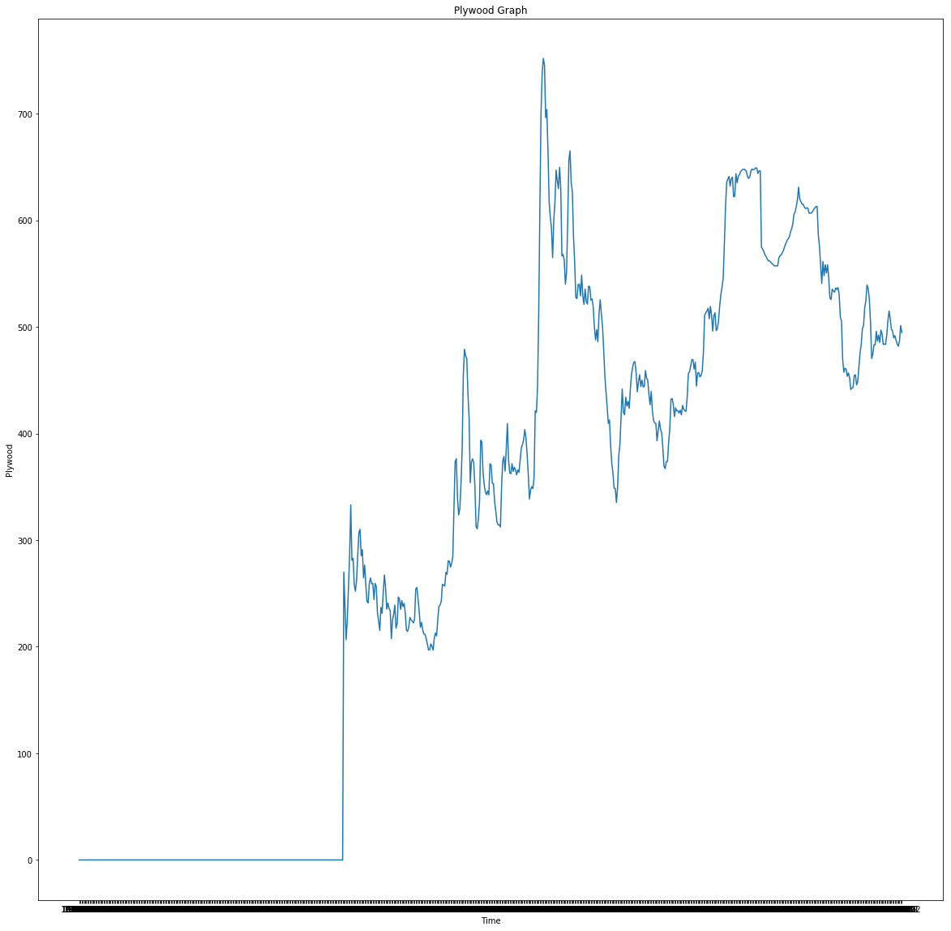
Plywood

Slide 29
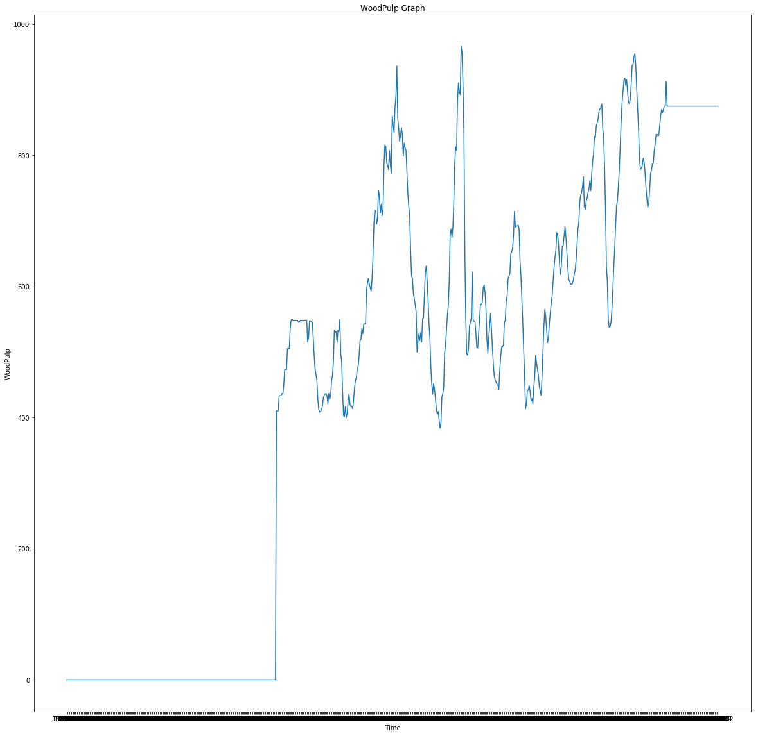
Wood pulp

Slide 30
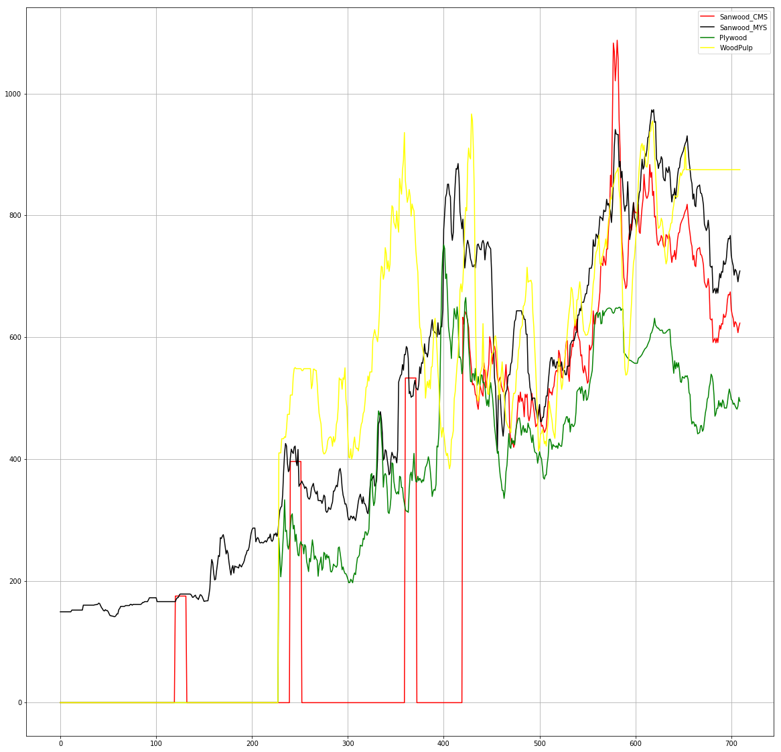

Slide 31
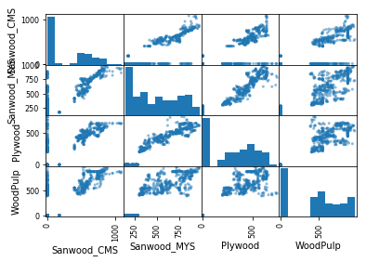

Slide 32
NATURAL GAS
Natural gas is a world commodity, with it prices are mainly driven by supply and demand factors of the country or continent. Natural gas price can be linked to the price of crude oil in Europe. Natural Gas prices in the US has historically followed oil prices, but in the recent years, it has decoupled from oil and are now trending somewhat with coal prices. The current surge in unconventional oil and gas in the U.S. has resulted in lower gas prices in the U.S.
Depending on the marketplace, the price of natural gas is expressed in US dollars (or other currency) per 1 million British thermal units MMBtu, thousand cubic feet (Mcf), or 1,000 cubic meters.
Note that, for natural gas price comparisons, $ per MMBtu multiplied by 1.025 = $ per Mcf of pipeline-quality gas, which is what is delivered to consumers.
Natural gas a comes out from the ground more often as methane, but may have a wide range of BTU values, from much lower (due to dilution by non-hydrocarbon gases) to much higher (due to the presence of ethane, propane, and heavier compounds) than standard pipeline-quality gas.^{[7}
The natural gas market in the United States is split between the financial (futures) market, based on the NYMEX futures contract, and the physical market, the price paid for actual deliveries of natural gas and individual delivery points around the United States. Market mechanisms in Europe and other parts of the world are similar, but not as well developed or complex as in the United States.

Slide 33
Henry Hub
The Henry Hub is a distribution hub on the natural gas pipeline system Erath, Louisiana owned by Sabine Pipe Line LLC a subsidiary of Enlink Midstream Partners LP who purchased the asset from Chevron Coporation in 2014.Due to its importance, it lends its name to the pricing for natural gas future contracts traded on the New York Mercantile Exchange (NYMEX) and the OTC sweeps traded on Intercontinental Exchange (ICE).

Slide 34
FACTORS FOR THE DEMAND OF NATURAL GAS
Weather
Demographics
Economic growth
Price increases, and poverty
Fuel competition
Storage
Exports

Slide 35
WEATHER
Weather conditions can significantly affect natural gas demand and supply. Cold temperatures in the winter increase the demand for space heating with natural gas in commercial and residential buildings. Natural gas demand typically peaks during the coldest months and tapers off during the warmest months, with a slight increase during the summer to meet the demands of electric generators. The weather during any particular season can affect this cyclical demand for natural gas. The colder the weather during the winter, the more pronounced will be the winter peak. Conversely, a warm winter may result in a less noticeable winter peak. An extremely hot winter can result in even greater cooling demands, which in turn can result in increased summer demand for natural gas. Natural gas demand usually peaks during the coldest months of the year (December–February) and is lowest during the "shoulder" months (May–June and September–October). During the warmest summer months (July–August), demand increases again. Due to the shift in population in the United States toward the sun belt, summer demand for natural gas is rising faster than winter demand. Temperature effects are measured in terms of 'heating degree days' (HDD) during the winter, and 'cooling degree days'(CDD) during the summer. HDDs are calculated by subtracting the average temperature for a day from 65 degrees. Thus, if the average temperature for a day is 50 degrees, there are 15 HDDs. If the average temperature is above 65 degrees, HDD is zero. Cooling degree days are also measured by the difference between the average temperature and 65 degrees. Thus, if the average temperature is 80 degrees, there are 15 CDDs. If the average temperature is below 65 degrees, CDD is zero.

Slide 36
DEMOGRAPHICS
(statistics) a statistic characterizing human populations (or segments of human populations broken down by age, sex or income etc.). Changing demographics also affects the demand for natural gas, especially for core residential customers. The changing demographics of the U.S. population also affect the demand for natural gas. Most significantly, according to WPA, recent demographic trends have seen an increased population movement to the Southern and Western states. As these areas are generally warmer climates, there will be an increase in demand for cooling, and less of a demand for heating. As electricity currently supplies most of the nation's space cooling energy requirements, and natural gas supplies most of the energy used for space heating, population movement may decrease natural gas demand in these sectors. However, as distributed generation and residential natural gas cooling technologies advance, and residential consumers can use natural gas to supply their electricity needs, natural gas demand could in fact increase. Another demographic trend is the aging of the large 'baby boomer' generation. It is expected that as this generation ages, their requirements for cooling in warm weather and heating in cooler weather will increase, thus driving demand for both electricity and natural gas.

Slide 37
ECONOMIC GROWTH
The state of the economy can have a considerable effect on the demand for natural gas in the short term. This is particularly true for industrial and to a lesser extent the commercial customers. When the economy is booming, output from the industrial sectors generally increases. On the other hand, when the economy is experiencing a recession, output from industrial sectors drops. These fluctuations in industrial output accompanying the economy affects the amount of natural gas needed by these industrial users. For instance, during the economic recession of 2001, U.S. natural gas consumption by the industrial sector fell by 6 percent.[

Slide 38
Price Increases and Poverty
Tariff increases and levels of household income also influence the demand for natural gas. A 2016 study assesses the expected poverty and distributional effects of a natural gas price reform – in the context of Armenia; it estimates that a significant tariff increase of about 40% contributed to an estimated 8% of households to substitute natural gas mainly with wood as their source of heating - and it also pushed an estimated 2.8% of households into poverty (i.e. below the national poverty line). This study also outlines the methodological and statistical assumptions and constraints that arise in estimating causal effects of energy reforms on household demand and poverty.

Slide 39
FUEL COMPETITION
Supply and demand dynamics in the marketplace determine the short term price for natural gas. However, this can work in reverse as well. The price of natural gas can, for certain consumers, affect its demand. This is particularly true for those consumers who have the ability to switch the fuel which they consume. In general the core customers (residential and commercial) do not have this ability, however, a number of industrial and electric generation consumers have the capacity to switch between fuels. For instance, when natural gas prices are extremely high, electric generators may switch from using natural gas to using cheaper coal or fuel oil. This fuel switching then leads to a decrease for the demand of natural gas, which usually tends to drop its price.

Slide 40
ANALYSIS
Through the 1960s the U.S. was self-sufficient in natural gas and wasted large parts of its withdrawals by venting and flaring. Natural gas flares were common sights in oilfields and at refineries. U.S. natural gas prices were relatively stable at around (2006 US) $30/Mcm and in the 1960s. Beginning in 1954, the Federal Power Commission regulated the price of US natural gas transported across state lines. The commission set the price of gas below the market rate, resulting 1970s, there were shortages of price-regulated interstate gas, while unregulated gas within the gas-producing states (intrastate gas) was plentiful, but more expensive. By 1975, nearly half the marketed gas in the US was sold to the intrastate market, resulting in shortages during 1976 and 1977 in the Midwest that caused factories and schools to close temporarily for lack of natural gas. The federal government progressively deregulated the price of natural gas starting in 1978, and ending with complete federal price deregulation in 1993. While supply interruptions citation needed have caused repeated spikes in pricing since 1990, longer range price trends respond to limitations in resources and their rates of development. As of 2006 the U.S. Interior Department estimated that the Outer Continental Shelf of the United States held more than 15 trillion cubic meters of recoverable natural gas, equivalent to about 25 years of domestic consumption at present rates. Total U.S. natural gas reserves were then estimated at 30 to 50 trillion cubic meters, or about 40 to 70 years consumption. The new technologies of hydraulic fracturing and horizontal drilling have increased these estimates of recoverable reserves to many hundreds of trillion cubic feet. Hydraulic fracturing has reduced the Henry Hub spot price of natural gas considerably since 2008. The increased shale gas production leads to a shift of supply away from the south to the northeast and Midwest of the country. A recent study found that, on average, natural gas prices have gone down by more than 30% in counties above shale deposits compared to the rest of the US, highlighting that natural gas markets have become less integrated due to pipeline capacity constraints.

Slide 41
Prices of natural gas for end-consumers vary greatly throughout Europe. One of the main objectives of the projected single EU energy market is a common pricing structure for gas products. A recent study suggests that the expansion of shale gas production in the U.S. has caused prices to drop relative to other countries, especially Europe

Slide 42
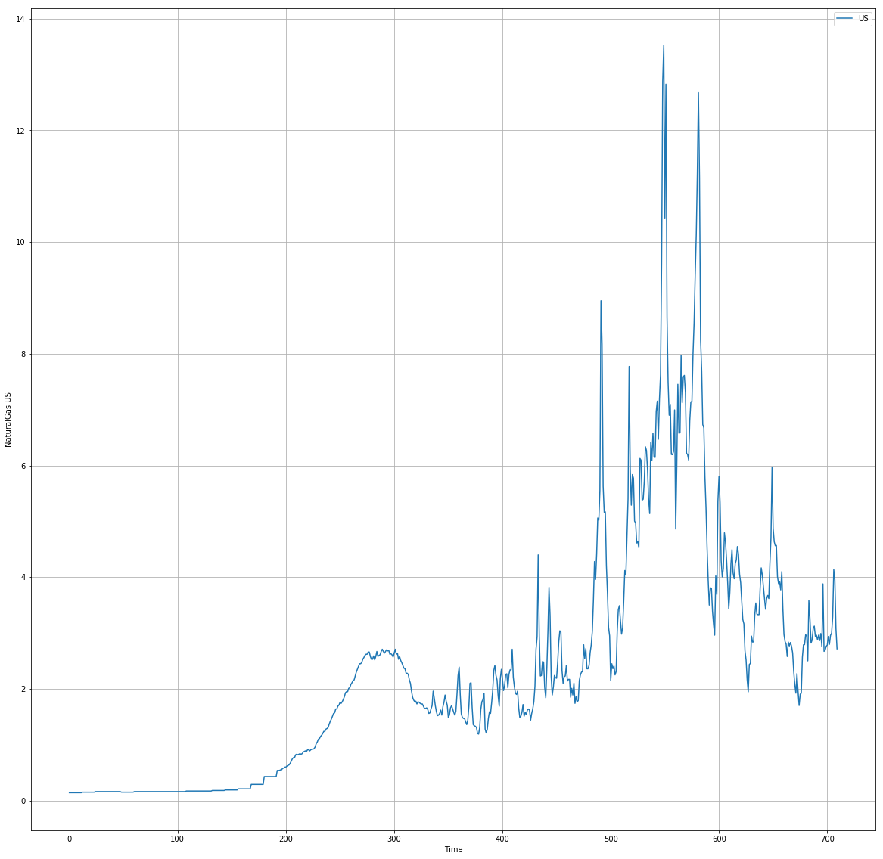

Slide 43
Weather conditions can significantly affect natural gas demand and supply. Cold temperatures in the winter increase the demand for space heating with natural gas in commercial and residential buildings. Natural gas demand typically peaks during the coldest months and tapers off during the warmest months, with a slight increase during the summer to meet the demands of electric generators. The weather during any particular season can affect this cyclical demand for natural gas. The colder the weather during the winter, the more pronounced will be the winter peak. Conversely, a warm winter may result in a less noticeable winter peak. Natural gas demand usually peaks during the coldest months of the year (December–February) and is lowest during the "shoulder" months (May–June and September–October). During the warmest summer months (July–August), demand increases again.
In 2001, you can see one of the first big spikes in natural gas prices. This was caused by an increase of demand after many years of declined production. After this, there was an economic downturn which caused the prices to drop. The state of the economy can have a considerable effect on the demand for natural gas in the short term. This is particularly true for industrial and to a lesser extent the commercial customers.

Slide 44
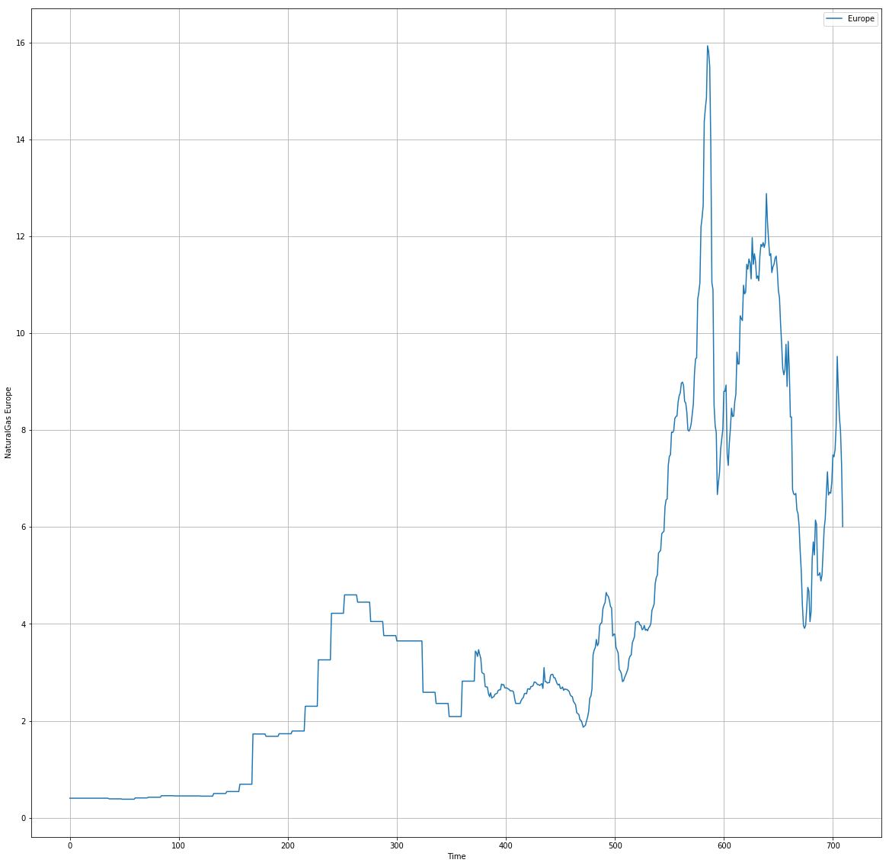

Slide 45
The availability of gas in storage and the outside temperature negatively influenced the gas price,the gas price was related to the production of wind electricity,temperature, storage and supply shocks lead to relatively short lasting effects on the gas price.Natural gas is the primary source of heating in North-west Europe and as such, demand from residential and commercial users mainly depends on the temperature. Gas consumption is higher in the cold autumn and winter periods and lower in the warmer spring and summer months.Moreover, a considerable part of electricity in North-west Europe is generated using natural gas as input. The demand for gas by gas-fired electricity generators depends primarily on the price of gas relative to other fuels used for electricity generation, in particular coal.
Supply disruptions had a profound impact on hub prices. Because production was concentrated within a limited number of producers, disruptions in the supply of one company lead to increased supply from more expensive sources or a decrease in total market supply. Given that,demand was relatively inelastic in the short run and the flexibility of the remaining sources of supply became limited lead to sharp increases in spot prices at hubs following supply shocks.

Slide 46
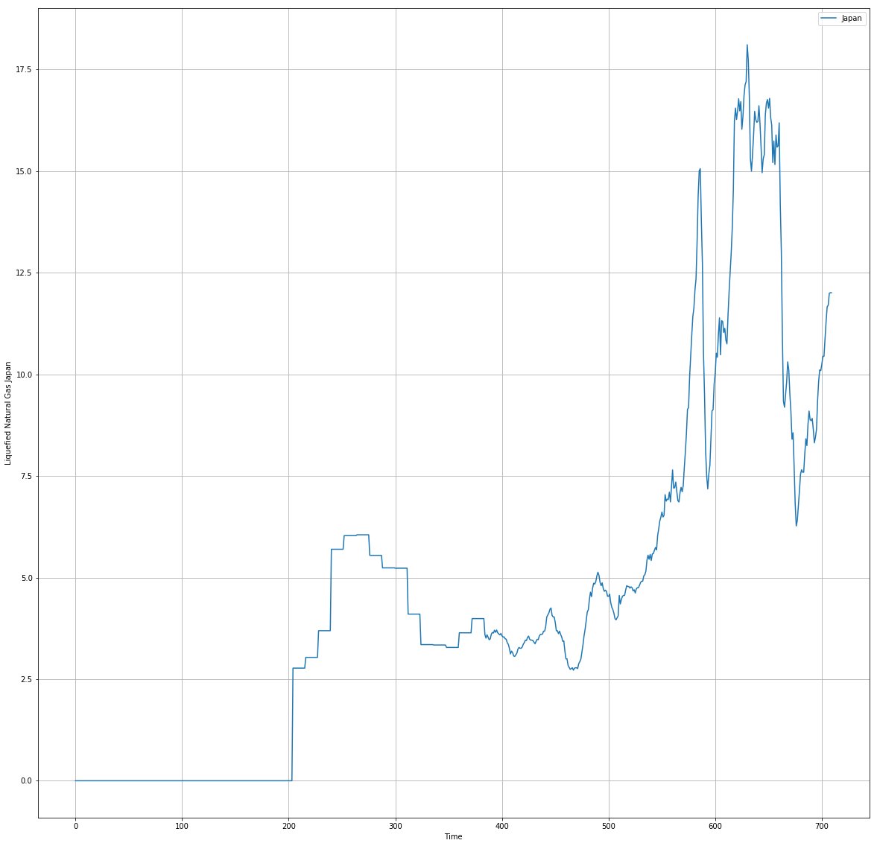

Slide 47
In 1950, coal supplied half of Japan's energy needs, hydroelectricity one-third, and oil the rest. By 2001, the contribution of oil had increased to 50.2% of the total, with rises also in the use of nuclear power and natural gas. Japan now depends heavily on imported fossil fuels to meet its energy demand. In the early 1960s air pollution in Japan led to enactment of environmental regulations, which stirred Japan's interest in importing LNG as a cleaner and more environmentally friendly fuel for power generation than coal and crude oil. Demand for LNG in Japan grew from around 17 MTPA in 1980 to more than 45 MTPA in 1990, largely due to a sharp increase in gas-powered electric generation. On the buying side, Japanese demand for LNG rose sharply in the wake of the 2011 disaster at the Fukushima No.1 nuclear power plant (NPP), which resulted in LNG being highlighted as a key alternative for meeting Japan's energy needs. Since September 2013, all of Japan's 48 viable nuclear reactors have been offline. Natural Dissasters that occured were the major factors that caused an increase in the price on natural gas,some that occured where: Oshima, Izu Islands(1990),Mount Yake, Honshu(1995),Mount Unzen, Kyushu(1996),and others.

Slide 48
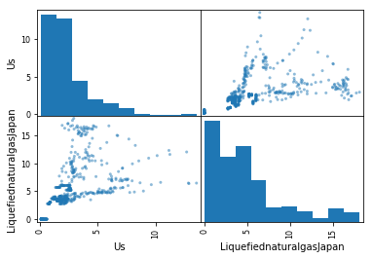

Slide 49
references
History behind crude oil.// www.ig.com
Uses of crude oil// www.biblemoneymatters.com
Reasons for changes in worldbank prices of crude oil// www.eia.gov

